Slide 1
E-MEDICARE
PROJECT MEMBERS
1. Ambati Amrutha (2528065)
2. Ankit Pandey (2526678)
3. Aditya Kumar Singh (2525939)
4. Aditya Mishra (2528614)
5. Anand Kharwar (2525788)
6. Arvind Kumar (2527904)
7. Amaravathy Palani (2529981)
8. Aliyas John (2529191)
9. Addala Ganga Sai (2528960)
10. Ankireddy Palli Vyshnavi (2527497)

Slide 2
ABSTRACT
The purpose of E-Medicare System is to automate the existing manual system by the help of computerized equipment's and full-fledged computer software, fulfilling their requirements, so that their valuable data/information can be stored for a longer period with easy accessing and manipulation of the same.
E-Medicare System, as described above, can lead to error free, secure, reliable and fast management system.

Slide 3
INTRODUCTION
The “Online Medical Store” has been developed to override the problems prevailing in the practicing manual system. This software is supposed to eliminate and reduce the hardships faced by the existing system. Online Medical Store can lead to error free, secure, reliable and fast management system.
"Online Medical Store" - web application, where users can register, login, purchase medicines and manage their orders in the system.

Slide 4
PROPOSED SYSTEM
The proposed Medicine ordering Store system will completely revolutionize the industry.
Searching of products, order placing, billing and product stock can be maintained by a single click.
The payment of the order can also be done via online.

Slide 5
TECHNOLOGY USED
HTML : Page layout has been designed in HTML
CSS : CSS has been used for all the designing part
JavaScript : All the validation task and animations has been developed by JavaScript
Java : All the business logic has been written in Java
MySQL : MySQL database has been used as database for the project
Angular CLI : Command-line interface tool that we use to initialize.

Slide 6
ENVIRONMENT
The system will be developed on any Windows OS machine using J2EE, Hibernate and Spring.
Server – Apache Tomcat 8
Database – My SQL
My SQL J Connector
Node Version 12
Angular CLI
JDK 1.8
Eclipse IDE or Spring Tool Suite

Slide 7
MODULES OF E-MEDICARE SYSTEM
Login Module: Used for managing the login details
Admin Module: Used for managing medicine details and user information.
Users Module: Used for managing the users of the system.
Update Module: Used for updating the Customer details.
Cart Module: Used for managing the details of Items in the Cart
Medicine Module: Used for managing the Medicine details(database)

Slide 8
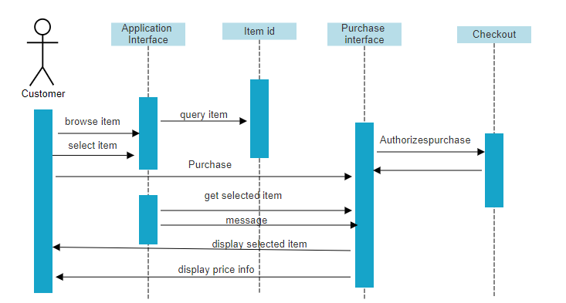
SEQUENCE DIAGRAM

Slide 9
ADVANTAGES
User can view details of the medicines without going anywhere.
It is convenient for users as this system provides accurate cost and description of the system.
The website is flexible to be used and for e-shopping.
User can view different categories of product of different pharma company at a single place.

Slide 10
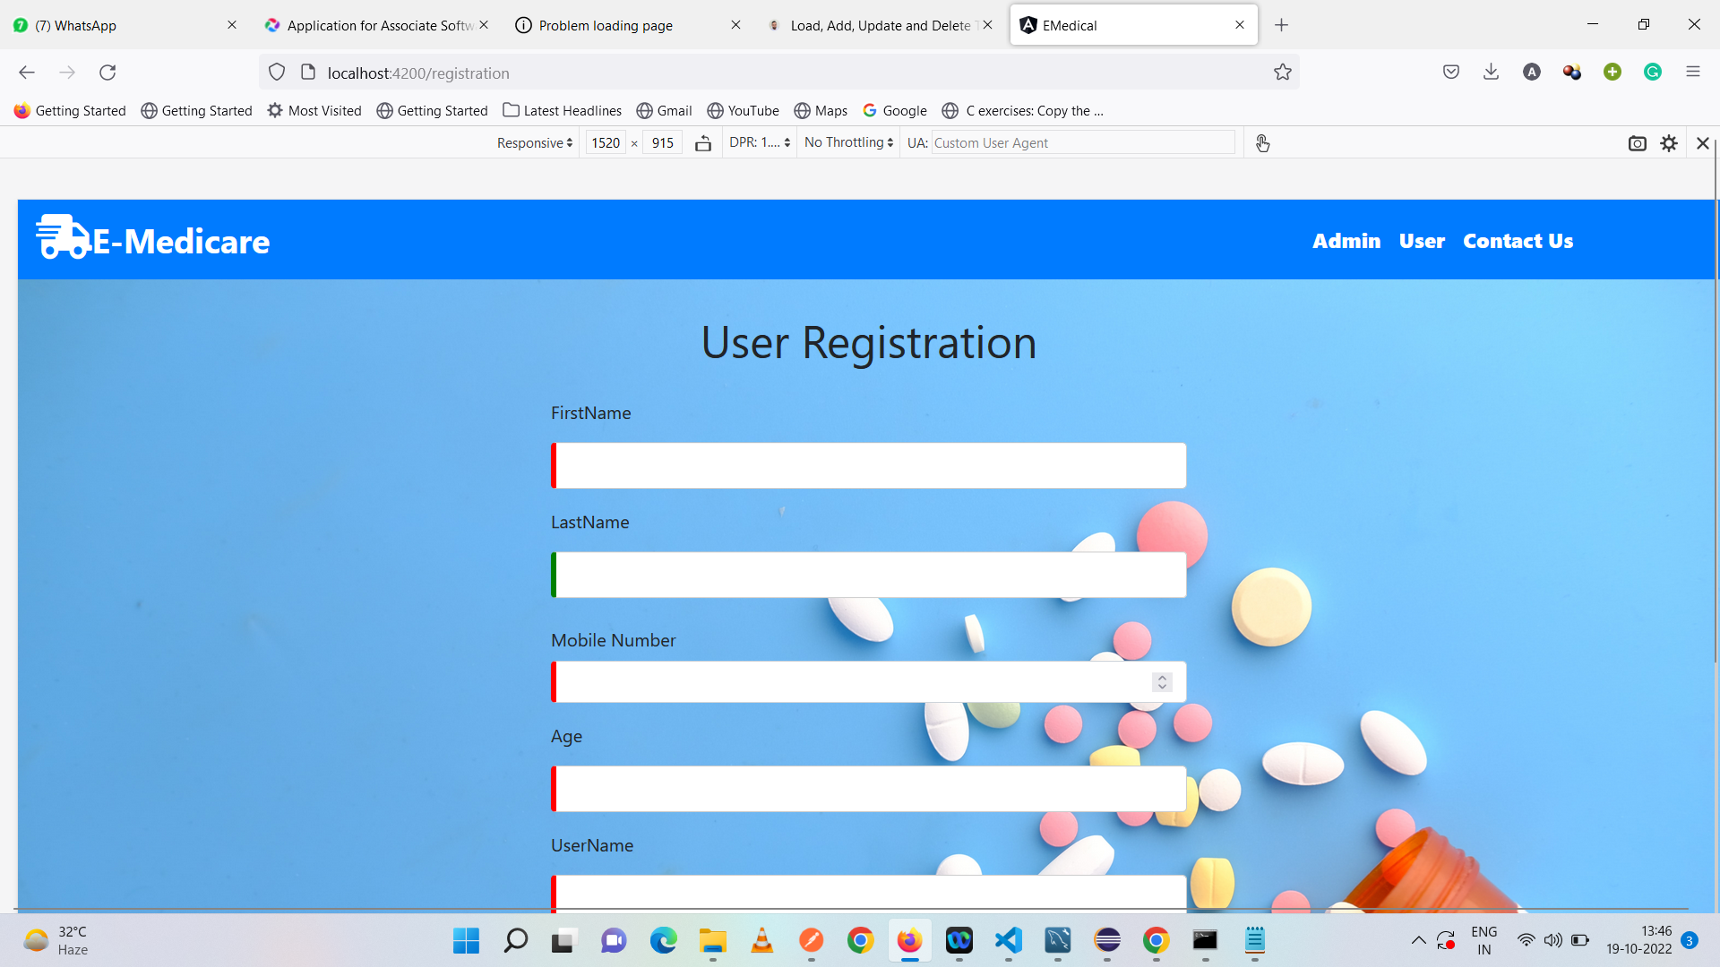
OUTPUT SCREENSHOTS
USER REGISTRATION

Slide 11
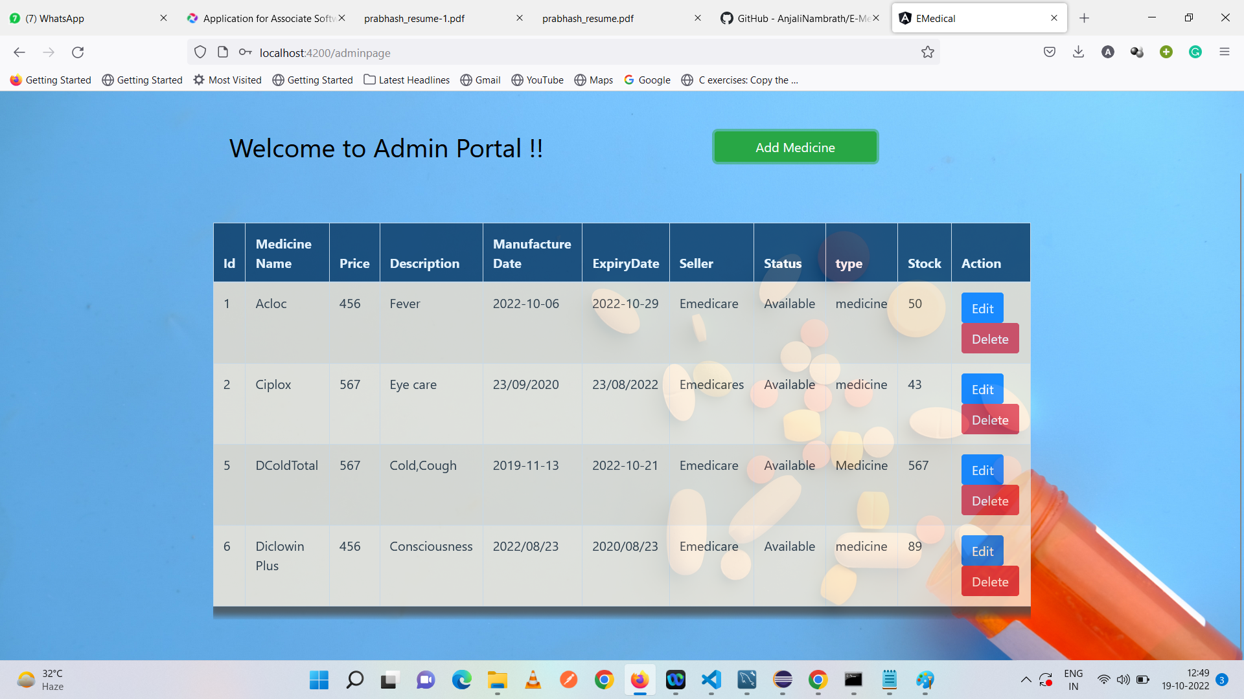
Admin portal

Slide 12
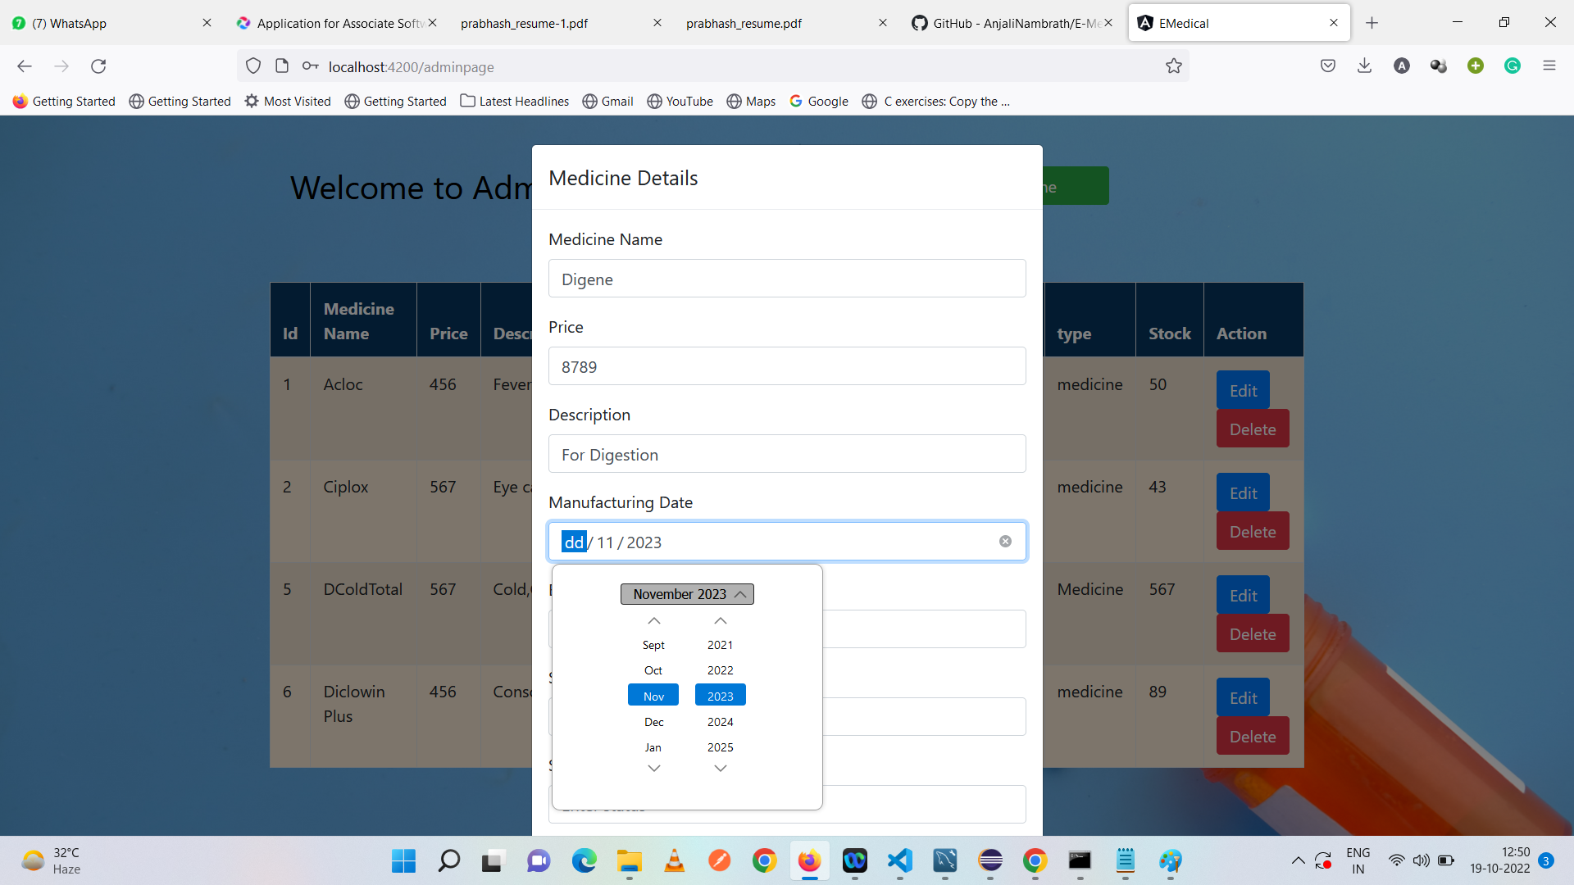
Adding Medicine

Slide 13
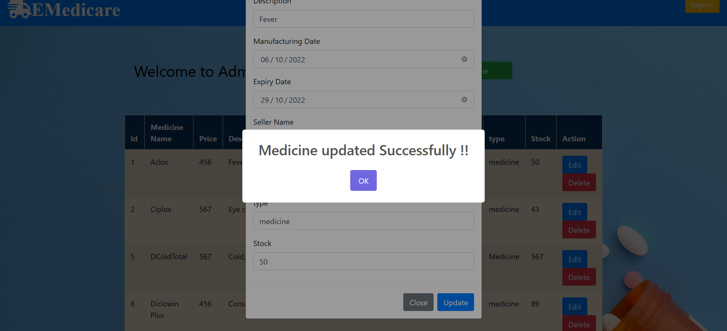
Updating /Editing Medicine Details

Slide 14
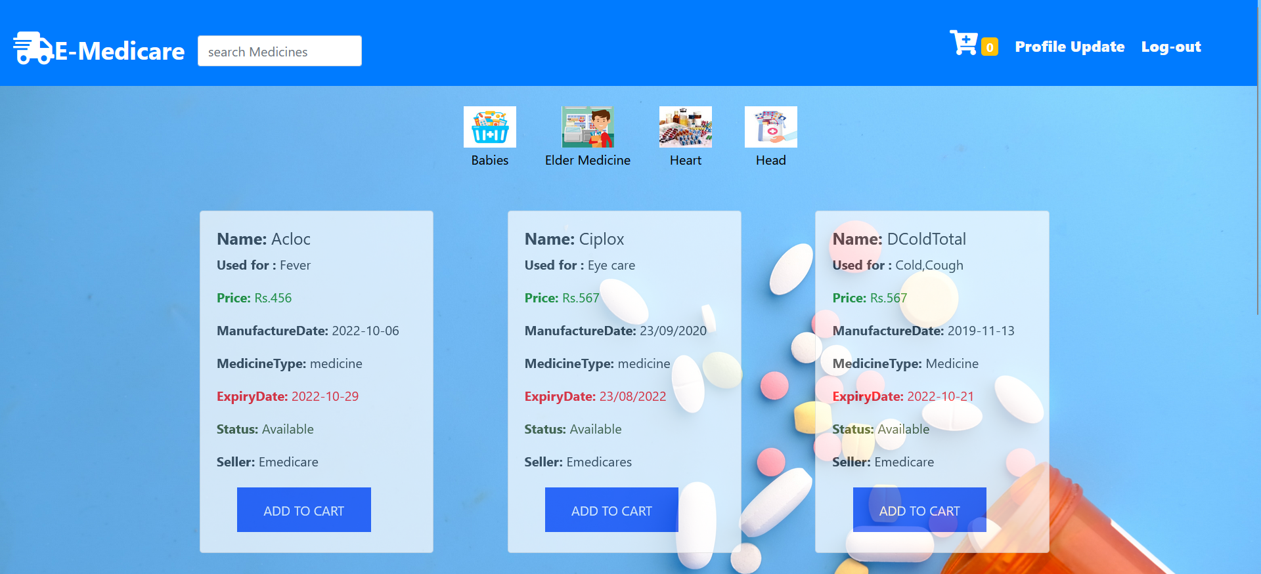
USER HOME PAGE

Slide 15
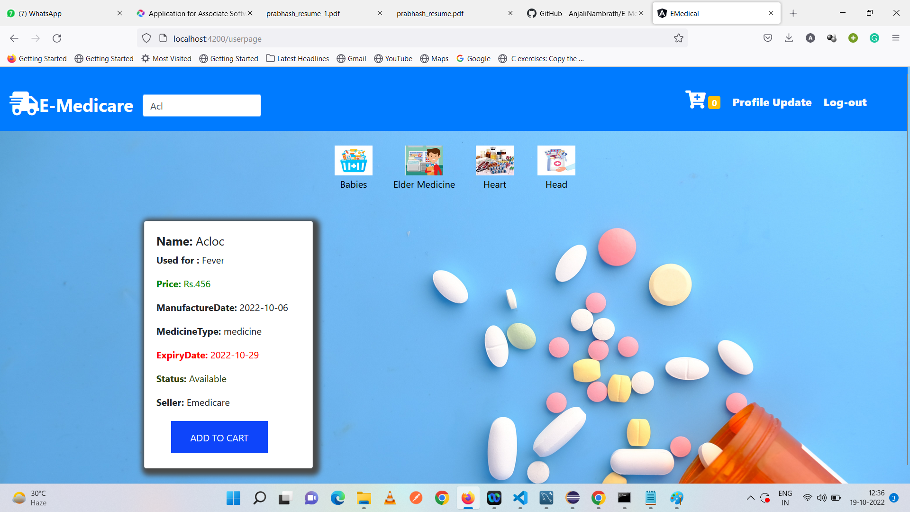
USING SEARCH BAR

Slide 16
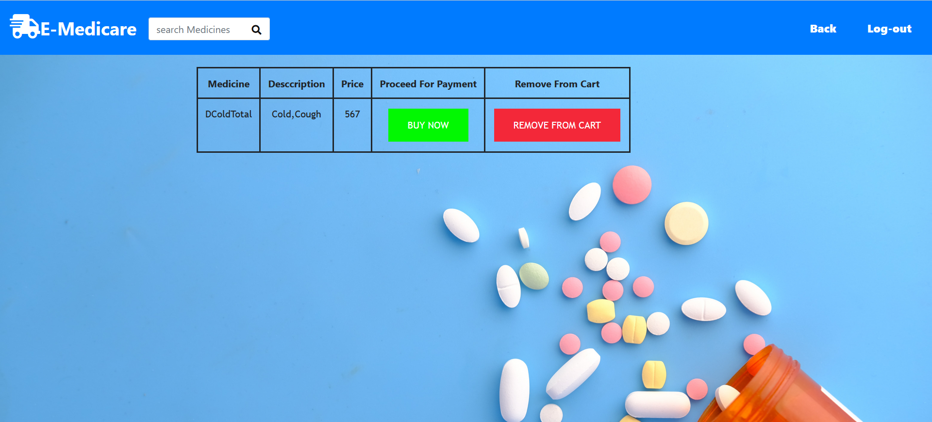
After adding product to Cart

Slide 17
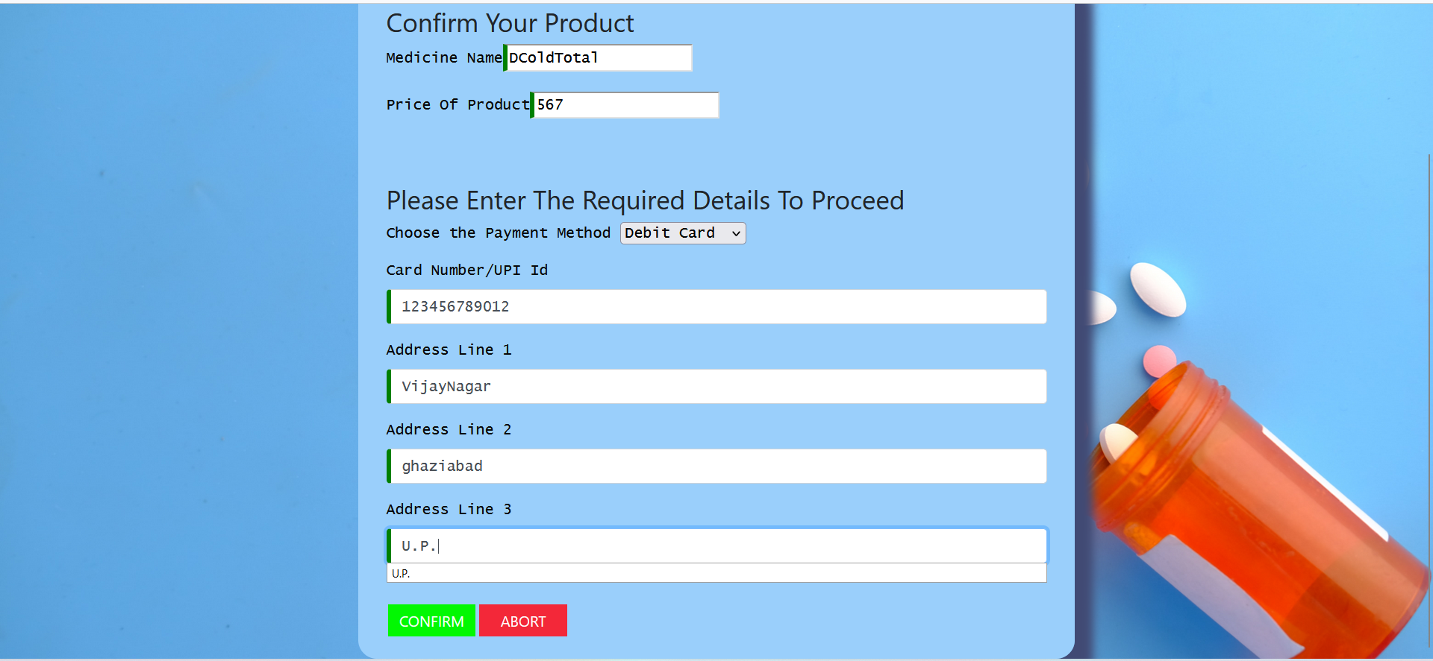
Checkout Form

Slide 18
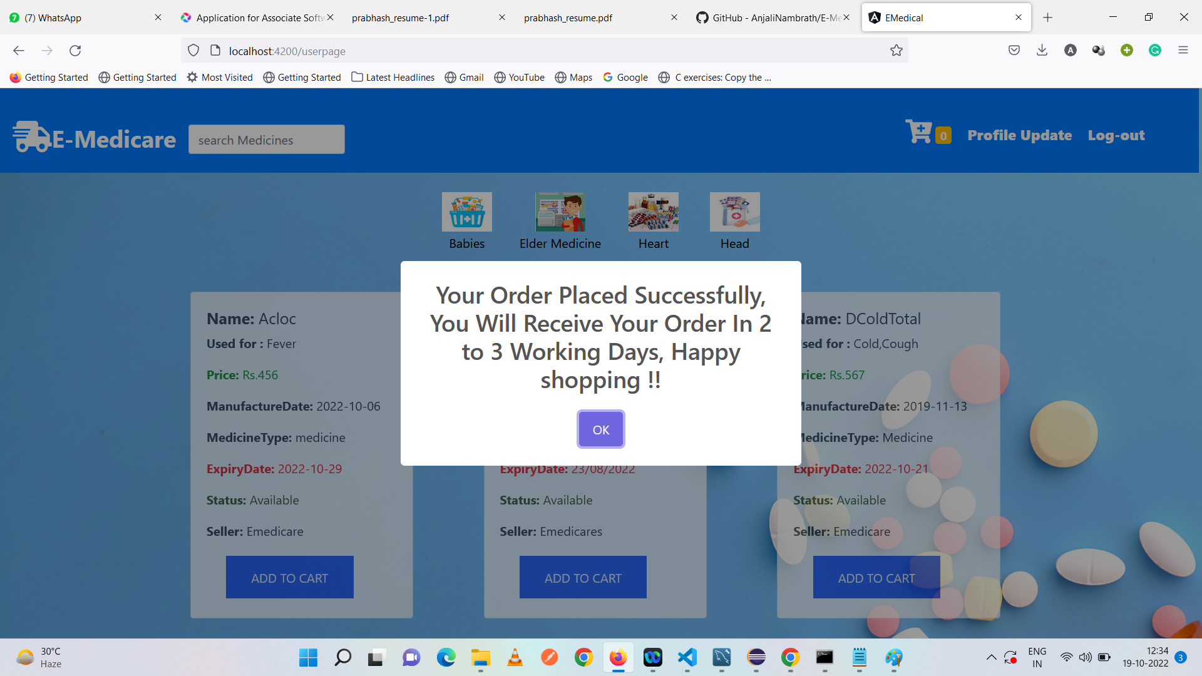
AFTER PLACING ORDER

Slide 19
CONCLUSION
Our project is only a humble venture to satisfy the needs to manage their project work. Several user-friendly coding has also adopted. The objective of software planning is to provide a frame work that enables the manger to make reasonable estimates made within a limited time frame at the beginning of the software project and should be updated regularly as the project progresses.
At the end it is concluded that we have made effort on following points
We understand the problem domain and produce a model of the system, which describes operations that can be performed on the system.
We included features and operations in detail, including screen layouts.
We designed user interface and security issues related to system.
Finally, the system is implemented and tested according to test cases.

Slide 20
THANK YOU

